Slide 1
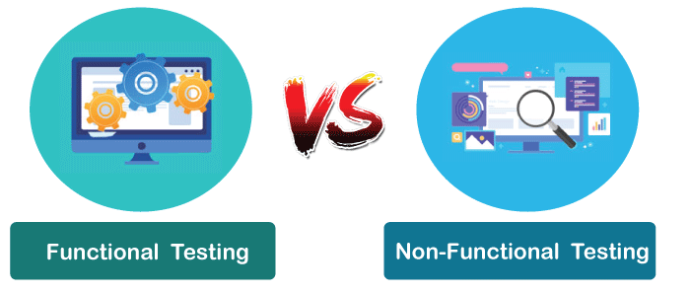
Levels of Testing
Functional Testing
Non-Functional Testing

Slide 2

Functional Testing
Functional testing focuses on functionality of the software or system.
The main goal of functional testing is to ensure that the software or system behaves as intended and meets the functional requirements specified in the design or requirements documentation.
The testers use test cases or scenarios to verify that the software meets the functional requirements.
For example, if you are testing an e-commerce website, functional testing would involve the tasks such as adding items to the cart, applying discounts, and processing payments correctly.
The testers would also check whether the website is user-friendly and whether the links, buttons, and menus work as intended.
It comes under Black-Box Testing.

Slide 3
Functional Testing Cont..
Integration Testing:
Software consist of many components and different developers are involved to design/develop the each individual component.
In Integration testing, two or more software components are tested together to test the interaction between them.
For eg:
1st developer create and design the code for adding the items into cart
2nd developer create and design the code for passing the cart items to buying process.
3rd developer create and design the code for processing the discount on the total bill.
4th developer create and design the payment processing.
So, In integration testing tester check if user is able to buy an items which were added into card after applying the required discount.

Slide 4
Functional Testing Cont..
Regression Testing:
It is common that when tester test a software then he encounters multiple defects, which developers fixes.
In Regression testing, tester test that a fix of one defect for particular functionality should not break the other working functionalities.
For eg:
When user enter password then he is getting error on Login.
Tester report a defect for the same.
Developer fixed the reported defect.
Tester test the fix and found that he is not even able to access the Login page.
So, In Regression testing tester check if user is able to use the existing functionalities after the bug fix.
It may be time-consuming as it is deep testing.

Slide 5
Functional Testing Cont..
Smoke Testing:
In Smoke Testing all the functionalities will get checked in detail whenever a new version of software build is going to release OR to check whether the particular version is working as expected.
In this testing, multiple members of one team are involved as it involves end to end testing.
This type of testing is well documented and planned.
For eg: There is a functionality of renaming a document via 3 ways.
Check user is able to rename a document.
Check user is able to rename a document with alphabets, digits, white spaces , unicode's etc.
Check user is able to rename a document via all the 3 possible ways.
Check user is getting success banner on renaming a document.

Slide 6
Functional Testing Cont..
Sanity Testing:
Sanity testing is not a planned testing and it can be performed whenever there is some bandwidth.
It is not a detailed testing like Smoke, and it only involves the main functionality check.
1 member of team can perform the sanity testing.
For eg: There is a functionality of renaming a document via 3 ways.
Check user is able to rename a document via all 3 ways or any 1 way.

Slide 7
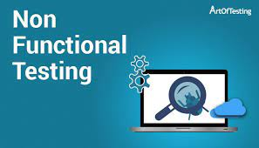
Non- Functional Testing
Non-functional testing, is focused on testing the non-functional aspects of the software, such as performance, security, usability, reliability, and compatibility.
It is Performed after the Functional Testing.
It helps to test and improve the overall performance of the software application.
For example:
If you are testing a website, you would check whether it can handle many concurrent users without slowing down or crashing.
You would also check whether the website is secure from potential cyber threats like hackers or viruses.
Additionally, you would check whether the website is accessible and easy for people with disabilities.

Slide 8
Non- Functional Testing Cont..
Performance Testing:
Performance testing is like checking how well a car works under different conditions to make sure it runs smoothly when you drive it.
Here's how it works:
Load Testing: It's like testing how fast your car can go with a lot of passengers or heavy luggage.
It checks if the software can handle many users or tasks at the same time without getting too slow or crashing.
Stress Testing: This is like pushing your car to the extreme, like driving at top speed for a long time or going up a steep hill.
Stress testing checks if the software can handle really tough situations without breaking.
Scalability Testing: Imagine you're adding extra seats to your car.
Scalability testing checks if the software can easily adapt to changes, like adding more users or making it work better on bigger computers.
Response Time Testing: It's like checking how quickly your car responds when you press the gas pedal.
Response time testing measures how fast the software responds to your actions, like clicking a button or loading a webpage.

Slide 9
Non- Functional Testing Cont..
Security Testing:
Security testing is like having a security guard check your house to make sure there are no open doors or windows where burglars could get in.
Here's how it works:
Checking for Open Doors and Windows: Just like the security guard checks for open entry points, security testing looks for vulnerabilities in your software's code or settings that hackers could exploit to gain unauthorized access.
Testing for Locks and Alarms: Security testing also checks if your software has the right security measures in place, like strong passwords, encryption, and firewalls. It ensures that your software is protected against common hacking techniques.
Protecting User Data: If your software deals with sensitive information like personal details or credit card numbers, security testing ensures that this data is stored and transmitted securely, so it can't be stolen.
Identifying and Fixing Weaknesses: If any security weaknesses are found during testing, they are reported so that they can be fixed. It's like repairing a broken lock or reinforcing a weak door to make your house more secure.

Slide 10
Non- Functional Testing Cont..
Usability Testing:
Usability testing is like checking if a new gadget or toy is easy to play with or use. Imagine you're trying out a new game, and you want to see if it's fun and not too hard to figure out.
Here's how it works:
Real People Using It: In usability testing, real people (not the creators) try out the software. They might be asked to perform specific tasks, like finding information on a website or using an app to do something.
Watching and Listening: While these people use the software, researchers watch and listen carefully. They want to see where users might get stuck, confused, or frustrated.
Taking Notes: Researchers take notes on what works well and what doesn't. They might ask the users questions about their experience, like if they found things easily or if they had any problems.
Improving the Design: After the testing, the creators of the software can use the feedback to make improvements. They might change the layout, buttons, or instructions to make it more user-friendly.
Repeat and Improve: Usability testing can be done several times with different users to keep making the software better and easier to use.

Slide 11
Non- Functional Testing Cont..
Compatibility Testing:
Compatibility testing is like making sure your favorite game or toy works on different devices or with different players.
Here's how it works:
Testing on Different Devices: Compatibility testing tries your software on various gadgets and setups, like different types of smartphones, tablets, and computers. It's like seeing if your game can be played on different game consoles or devices.
Checking with Different Browsers: Just like some friends may use different gaming controllers, some people use different web browsers (like Chrome, Firefox, or Safari) to access websites. Compatibility testing makes sure your website or app looks and works correctly on all these browsers.
Testing with Various Operating Systems: People use different operating systems, like Windows, macOS, Android, or iOS. Compatibility testing checks if your software runs smoothly on all these systems, just like your game needs to work on different gaming platforms.
Different Screen Sizes and Resolutions: Some people have big TV screens, while others have smaller ones. Compatibility testing ensures that your software looks good and functions well on screens of all sizes, just like your game should adapt to different TV sizes.
Adapting to Different Network Speeds: Some players may have fast internet, while others have slower connections. Compatibility testing considers these variations and ensures your software loads and performs well regardless of the internet speed, similar to how games should work smoothly on slow or fast connections.

